Slide 1
Machine Learning – RIME 832 Neural Networks

Slide 2
Motivation
Yet another non-linear classifier
To learn more complex non-linear hypothesis
State of the art technique for machine learning

Slide 3
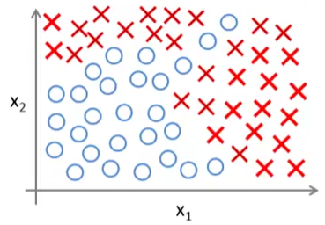
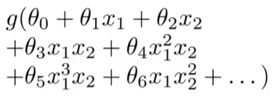
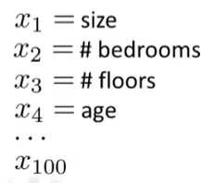
Motivation
Logistic Regression
Works well for small number of features only !
Let’s change our regression problem to classification problem.
Can we predict is a house will be sold in next maybe 6 months?
Imagine the number of terms with n = 100
Complexity of features: O(n³) if we only consider cubic terms

Slide 4

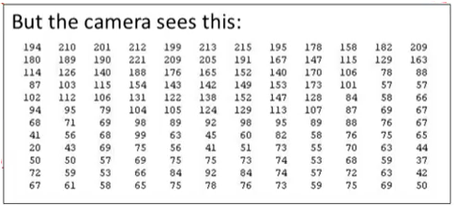
Motivation
What is this?

Slide 5
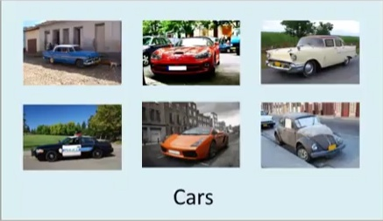
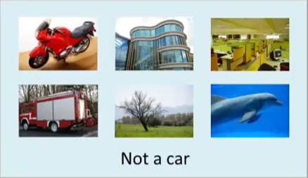
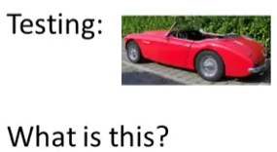
Motivation

Slide 6


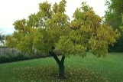


pixel 1
Learning Algorithm
pixel 2
Raw image
pixel 2
Cars
pixel 1
“Non”-Cars

Slide 7
pixel 1
Learning Algorithm
pixel 2
Raw image
pixel 2
Cars
pixel 1
“Non”-Cars

Slide 8

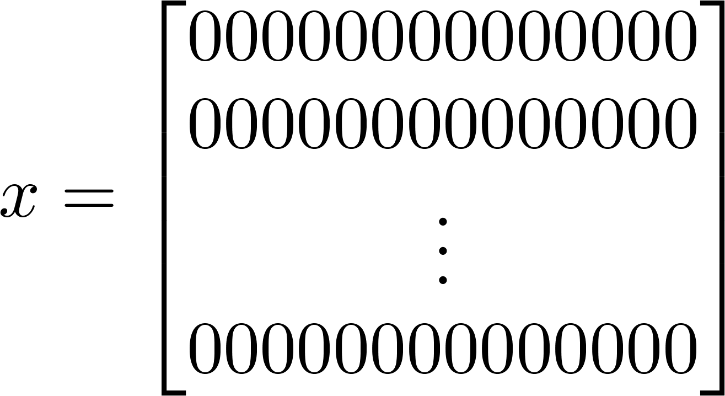


pixel 1
Learning Algorithm
pixel 2
Raw image
50 x 50 pixel images→ 2500 pixels
(7500 if RGB)
pixel 2
pixel 1 intensity
pixel 2 intensity
pixel 2500 intensity
Cars
pixel 1
Quadratic features ( ): ≈3 million features
“Non”-Cars

Slide 9
Why we need non-linear hypothesis?
Example on Google images……
Dimension complexity …….
When n is large, logistic regression is …..

Slide 10
Neural Networks
Inspired by human brains
Widely used in 80, use diminished in 90s, now most widely used ….
Resurgence due to state of the art results on different problems.
Different parts of brain learns to perform different tasks.

Slide 11
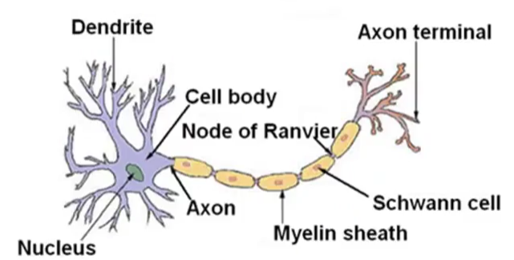
Neural Networks: Representation
Our brains are jam packed with neurons
Dendrite -> input wires
Axon-> output wires
Neuron-> computational unit that gets some input, performs computation and sends out the signal through output wires
Communicates with other neurons through pulses

Slide 12
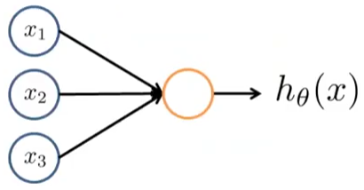
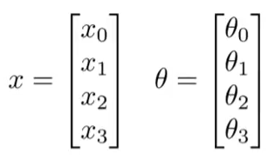


Neural Networks: Representation
Neuron model: Logistic unit
Bias Unit
X₀
Also known as “weights”
NOTE: It is a Neuron with Sigmoid(logistic) activation function

Slide 13
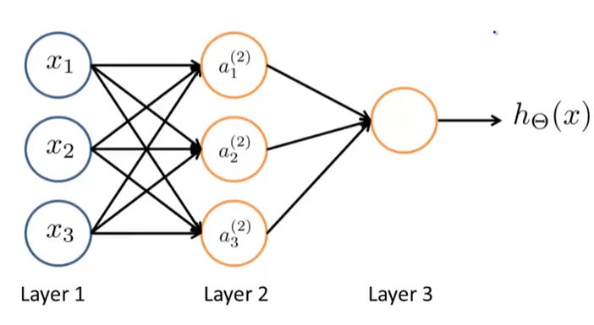
Neural Networks: Representation
Bias unit
X₀
a₀
Input Layer
hidden Layer
output Layer

Slide 14
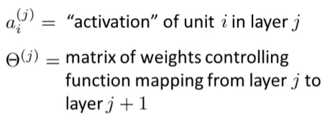
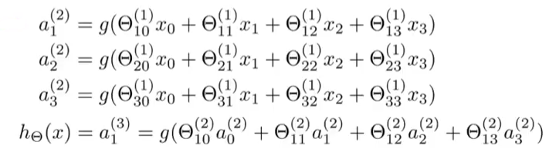
Neural Networks: Representation
What is θ⁽¹⁾ ?

Slide 15
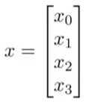
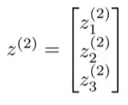
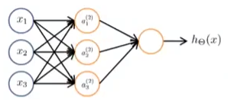

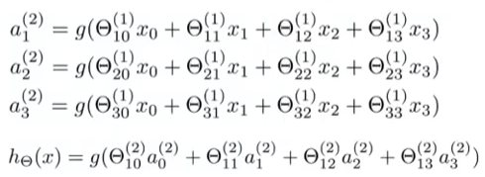
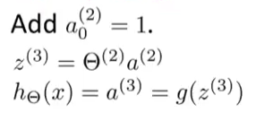
Neural Networks: Forward Propagation
a₁⁽²⁾ = g(Z₁⁽²⁾ )
a₂⁽²⁾ = g(Z₂⁽²⁾ )
a₃⁽²⁾ = g(Z₃⁽²⁾ )
Z₁⁽²⁾
Z₂⁽²⁾
Z₃⁽²⁾
This process of computing hypothesis is called as forward propagation.

Slide 16
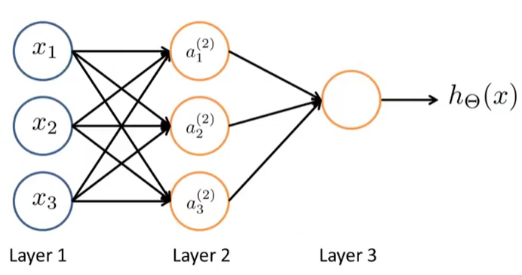
Neural Network: Learning features by itself
Discussion
Not constrained to particular features

Slide 17
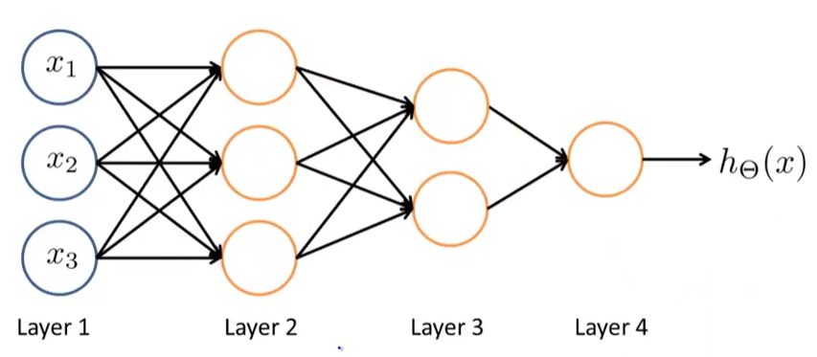
Neural Network: Other Architectures

Slide 18
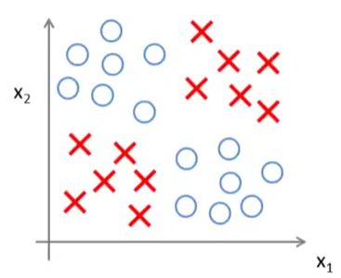
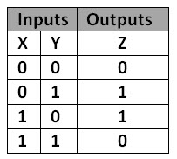
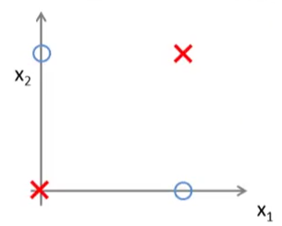
Examples and Intuitions
Non-linear classification example: XNOR
Y= X1 XNOR X2
Can a neural network learn such functions?
Simplified version, X1 and X2 are binary

Slide 19
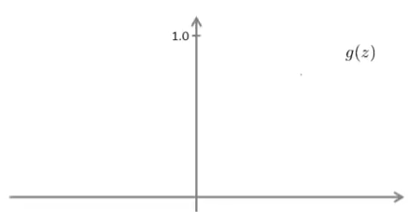

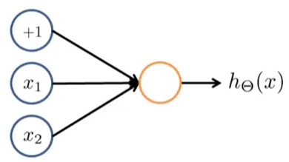
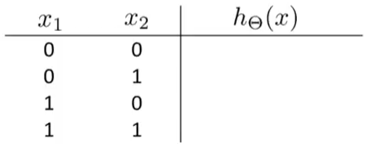
Examples and Intuitions
Example: Logical AND
-30
+20
+20
0
0
0
1
h_{θ}(x)=g(-30 + 20X₁ + 20X₂ )

Slide 20
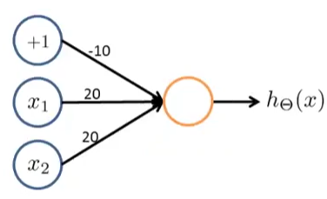
Example
Which function it is?

Slide 21
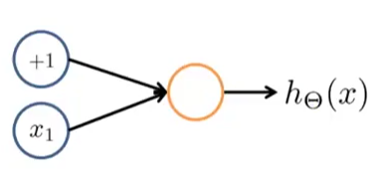
Example
Which function it is?
10
-20

Slide 22
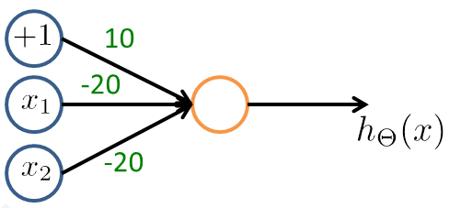
Example
Which function is this?

Slide 23
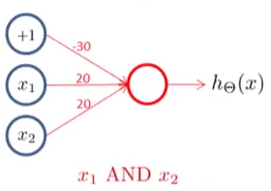
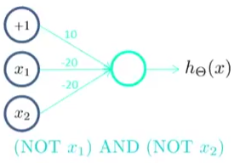
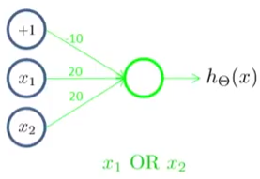
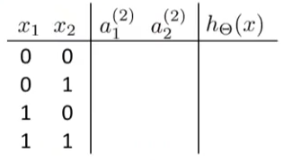
Back to XNOR
+1
+1
-30
a₁⁽²⁾
-10
20
20
20
a₁⁽³⁾
X₁
h_{θ}(x)
-20
10
a₂⁽²⁾
X₂
20
0
0
0
1
1
0
0
0
1
0
0
1
-20

Slide 24
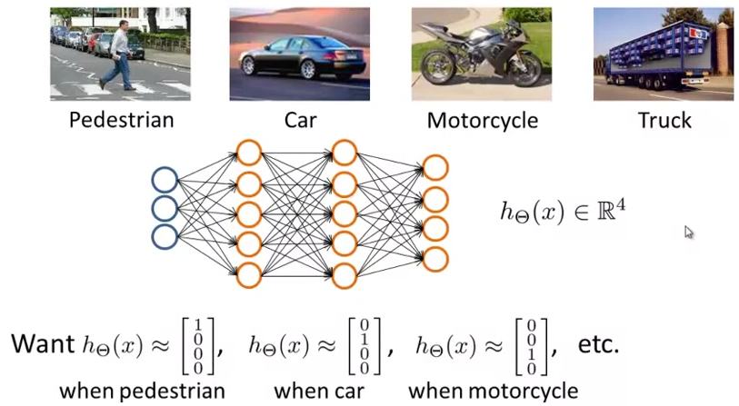
Multiclass classification

Slide 25
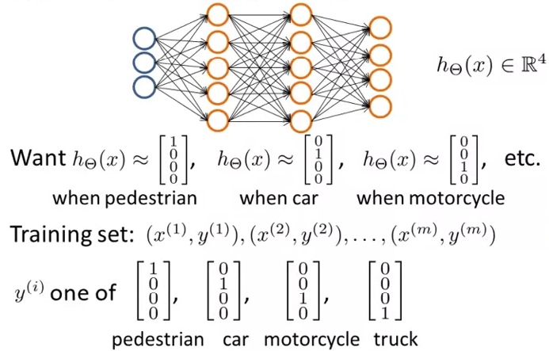
Multiclass classification

Slide 26
Cost Function
How to learn the parameters of Neural Networks automatically?

Slide 27
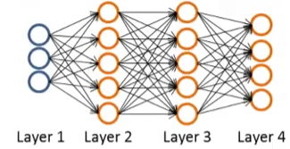


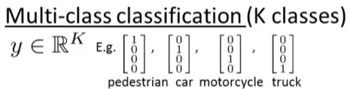


Cost Function

Slide 28
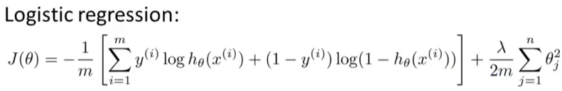
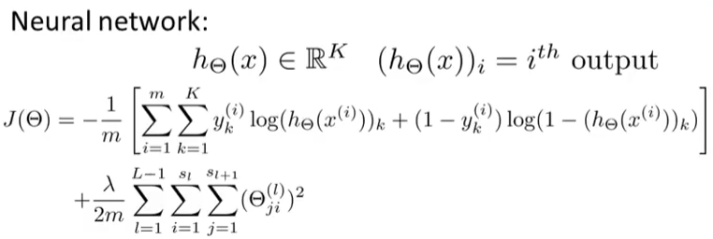
Cost Function

Slide 29
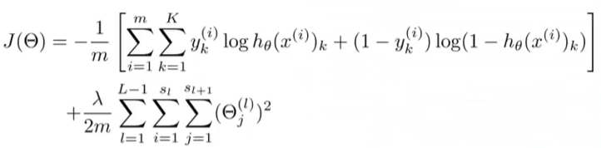



Backpropagation Algorithm
To optimize the previously defined cost function
Need to compute:
and

Slide 30
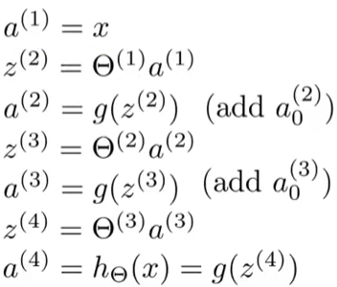
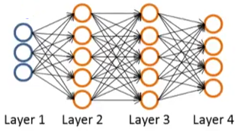
Backpropagation Algorithm
Given only one training example (x,y)
Forward Propagation
a⁽²⁾
a⁽³⁾
a⁽⁴⁾
a⁽¹⁾

Slide 31
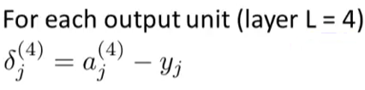


Backpropagation Algorithm
Actual label/output
(h_{θ}(x))_{j}
Derivative of activations of 3rd layer. It is equal to
a⁽³⁾ .* (1-a⁽³⁾)
We are essentially backpropagating the errors from output to the input
a⁽²⁾ .* (1-a⁽²⁾)

Slide 32
Backpropagation Algorithm
We can prove (out of scope) that
Hence we can use delta’s to get the partial derivatives of the cost function
= a_{j}^{(L)} δ_{i}^{(L+1)}

Slide 33

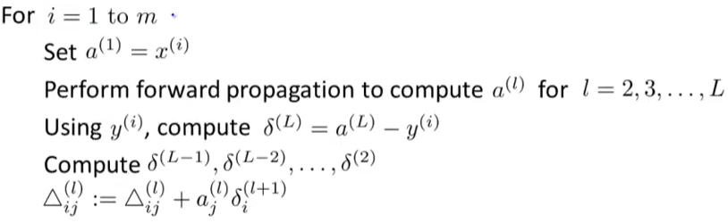
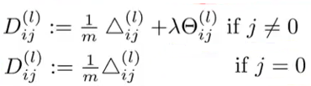

Backpropagation Algorithm
to compute
Also act as accumulators
No bias, no regularization

Slide 34
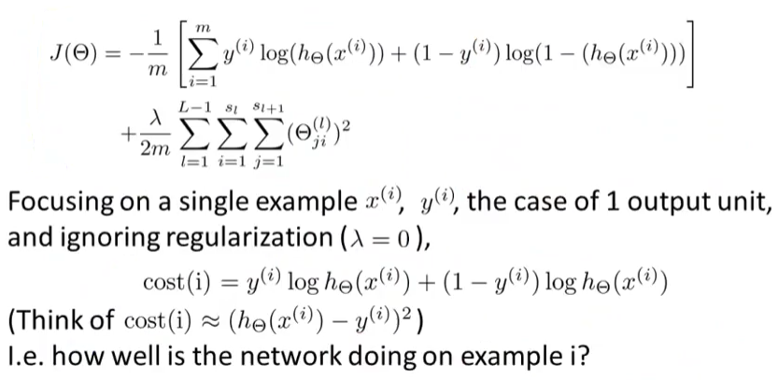
Backpropagation Algorithm

Slide 35
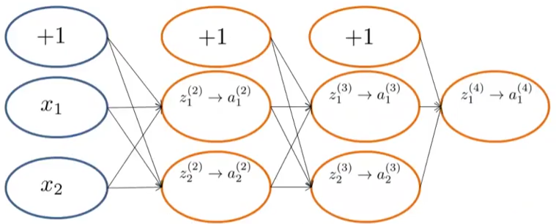
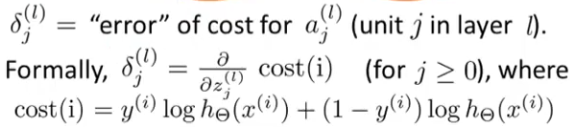
Backpropagation Algorithm
Z₁⁽³⁾ = θ₁₀⁽²⁾ x 1 + θ₁₁⁽²⁾ x a₁⁽²⁾ + θ₁₂⁽²⁾ x a₂⁽²⁾

Slide 36
Gradient Checking
Helps to check our forward and backward propagation implementations

Slide 37

Gradient Checking
We numerically estimate the gradients
J(θ+ε)-J(θ-ε)
2ε
Θ-ε
θ
θ+ε
d/dθ (J(θ)) = [J(θ+ε)-J(θ-ε)]/2ε
Choose small ε

Slide 38



Generalization
(E.g. is “unrolled” version of )

Slide 39

Gradient Checking

Slide 40
Weight/Parameter Initialization
For optimization algorithms such as gradient descent we need to choose initial values for parameters or weights.
Can we initialize all parameters to zero?

Slide 41


Zero Initialization

Slide 42

Random Initialization

Slide 43
Neural Network Summary
First pick a network architecture (connectivity pattern between neurons)
No. of input units: Dimension of features
No. output units: Number of classes
Reasonable default: 1 hidden layer, or if >1 hidden layer, have same no. of hidden units in every layer (usually the more the better)

Slide 44





Neural Network Summary
Training Neural Network
Randomly initialize weights
Implement forward propagation to get for any
Implement code to compute cost function
Implement backprop to compute partial derivatives
for i = 1:m
Perform forward propagation and backpropagation using example
(Get activations and delta terms for ).

Slide 45

Neural Network Summary
Use gradient checking to compare computed using backpropagation vs. using numerical estimate of gradient of . Then disable gradient checking code.
Use gradient descent or advanced optimization method with backpropagation to try to minimize as a function of parameters

Slide 46
Neural Network Summary
Non-linear decisions without the need to greatly expand the feature space

